Slide 1
Class 4 China Shock
PubPol 201
Module 3: International Trade Policy

Slide 2
China Shock
What is (was) the China Shock?
The very rapid growth of China’s exports to world markets
After they opened their markets in the 1980s
And especially after they joined with WTO in 2001
This had large effects on the US, which we will study

Slide 3
China Shock
Why study the China Shock?
It’s usually hard to study the effects of trade empirically, because so much else happens.
The China shock was big enough and special enough to isolate its effects
Implications matter for more than just trade with China

Slide 4
Class 4 Outline
China Shock
China’s growth
The China Shock
The ADH analysis
Other sources

Slide 5
Class 4 Outline
China Shock
China’s growth
The China Shock
The ADH analysis
Other sources

Slide 6
China’s Growth
Was China’s growth expected?
Not by the Wall Street Journal, June 23, 1989
Expected growth leaders:
Bangladesh, Thailand, and Zimbabwe
Expected laggard: China
Due to “the stultifying bureaucracy of hard-line communism”

Slide 7
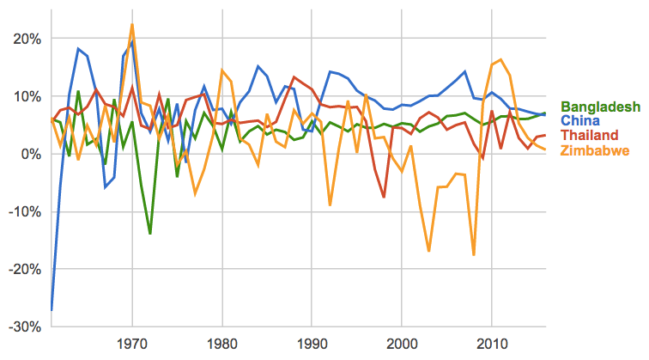
GDP Growth Rates
Source: World Bank
Notes:
https://www.google.com/publicdata/explore?ds=d5bncppjof8f9_&met_y=ny_gdp_mktp_kd_zg&idim=country:CHN:IND:USA&hl=en&dl=en#!ctype=l&strail=false&bcs=d&nselm=h&met_y=ny_gdp_mktp_kd_zg&scale_y=lin&ind_y=false&rdim=region&idim=country:CHN:THA:ZWE:BGD&ifdim=region&hl=en_US&dl=en&ind=false

Slide 8
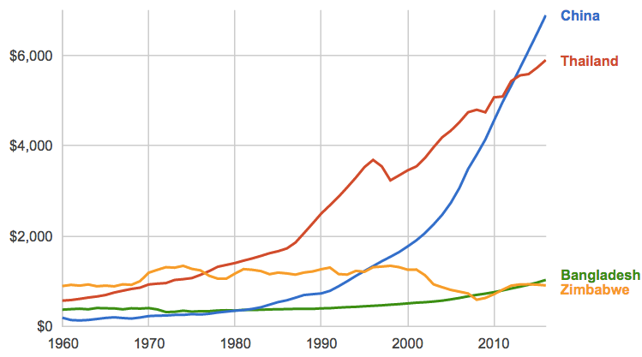
GDP per capita (Constant 2000$)
Source: World Bank

Slide 9
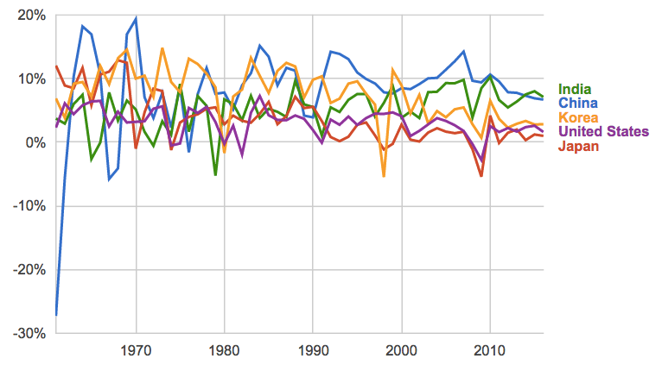
GDP Growth Rates
Source: World Bank

Slide 10
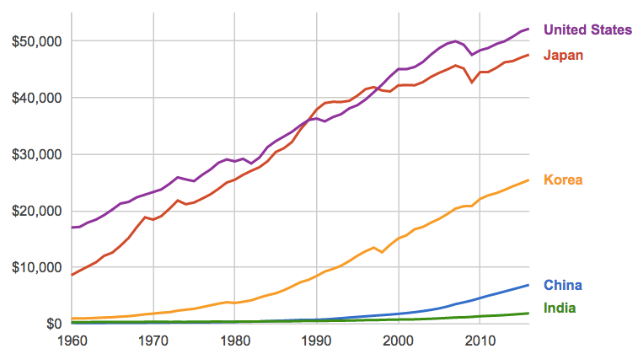
GDP per capita (Constant 2000$)
Source: World Bank

Slide 11
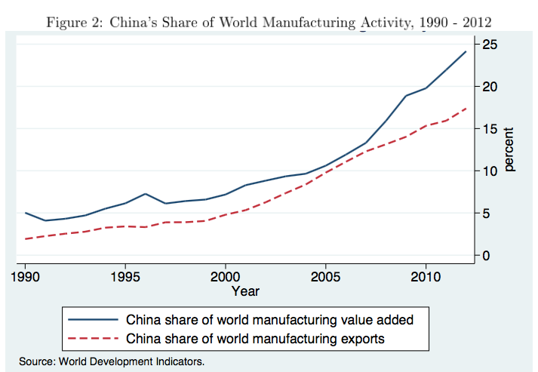
China’s WTO Entry

Slide 12
Clicker Question
Imports from China accelerated after it entered the WTO in 2001. When did employment in US manufacturing begin to decline?
1945
1980
2001
2008
✓

Slide 13
Clicker Question
In the most recent data reported here, which country’s GDP is growing fastest?
China
India
Japan
South Korea
United States
✓

Slide 14
China’s Growth
Why China’s export growth accelerated after joining WTO in 2001
Not because others reduced tariffs on Chinese exports. They didn’t.
Instead they required China itself to lower tariffs and make other changes

Slide 15
China’s Growth
Why China’s export growth accelerated after joining WTO in 2001
Privatization of some former SOEs (state-owned enterprises) made them more efficient.
Phased out restrictions that had inhibited exports.
Lower Chinese tariffs gave industries cheaper imported inputs, making them more productive.
Reduced uncertainty about foreign tariffs, unblocking investment.
US applied WTO (MFN) tariffs to China’s exports
But each year US debated whether to continue

Slide 16
Class 4 Outline
China Shock
China’s growth
The China Shock
The ADH analysis
Other sources

Slide 17
China Shock
Why study the China Shock?
It’s important for its own sake
Many think it is the cause of the large decline in US manufacturing
But look at the data
That decline started long before the China Shock

Slide 18
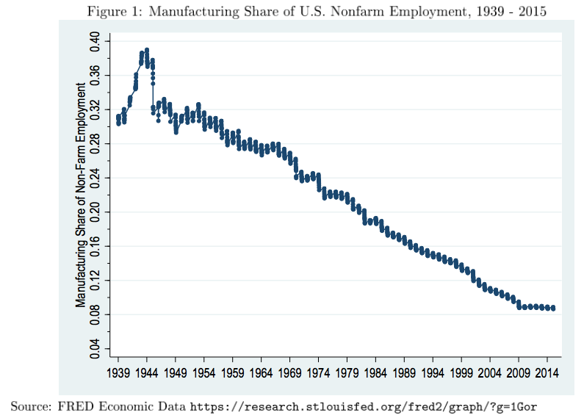

Slide 19
China Shock
Why study the China Shock?
Also, it’s usually hard to find evidence of how trade affects an economy
Changes in trade are usually
Accompanied by many other changes
Caused in part by the economies you want to study
Thus causation is hard to figure out
But the China Shock was plausibly a “natural experiment”
A change in the real world similar to a controlled experiment

Slide 20
China Shock
Why study the China Shock?
Whay was the China Shock plausibly a “natural experiment”
China’s growth, and the growth of its trade, were unexpected
Its cause was largely the extreme isolation of China under Mao
Its comparative advantage was distinctive: much of manufacturing but not primary products or resources

Slide 21
China Shock
Why study the China Shock?
So the China Shock can give us information about how other changes in trade, including smaller ones, may affect an economy like the US

Slide 22
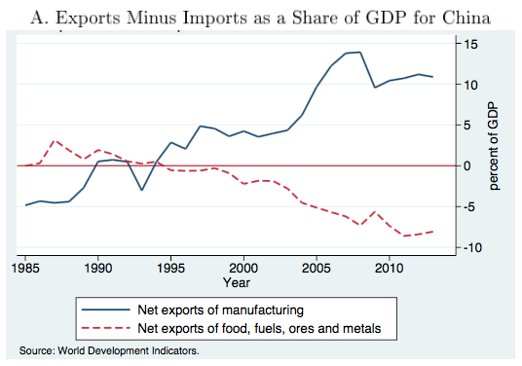
China’s WTO Entry

Slide 23
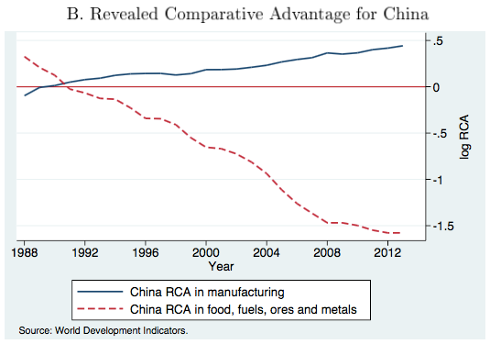
China’s WTO Entry
“Revealed comparative advantage” uses a formula to try to infer a country’s comparative advantage from data on its, and the world’s, trade.

Slide 24
China Shock
Nature of the China Shock
China’s growth of exports to the US was broad
Covering most of manufacturing
Greatest in most labor-intensive sectors
Varied in size across products within an industry
The variation suggests that effects will differ across localities in US, which specialize in different products
So the natural experiment differs across localities, giving multiple observations to study

Slide 25
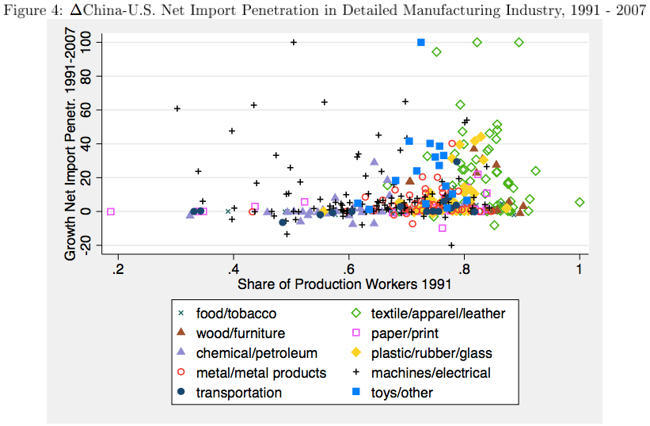
Measure of labor intensity

Slide 26
Clicker Question
Why do economists sometimes use “natural experiments”?
Natural experiments do not require funding
To avoid being accused of actions that are unnatural
Because they cannot themselves control economic conditions
Natural experiments are welcomed because they are beneficial to their subjects
✓

Slide 27
Discussion Question
The data show clearly that US imports from China rose at the same time that US manufacturing fell. Why is that, by itself, NOT enough to tell us that imports were harmful to the US?

Slide 28
Class 4 Outline
China Shock
China’s growth
The China Shock
The ADH analysis
Other sources

Slide 29
The ADH Analysis
The data show
Simultaneous growth in
China’s current account surplus
US’s current account deficit

Slide 30
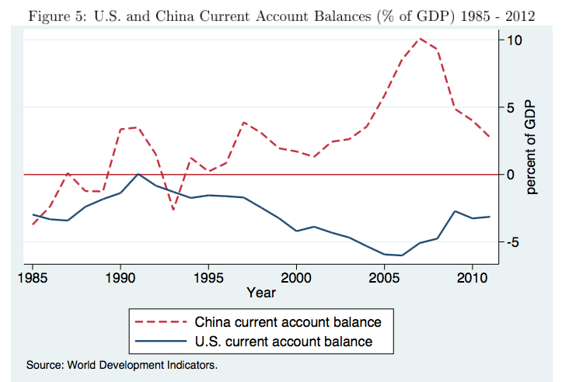
China’s WTO Entry

Slide 31
The ADH Analysis
The data show
Simultaneous growth in
China’s current account surplus
US’s current account deficit
That over the whole period 1991-2011, as well as sub-periods, across industries
Imports from China grew
Employment fell

Slide 32
𝚫 = change
Log 𝚫 = change in the logarithm ≈ percent change
SD = standard deviation (measure of how different observations are)

Slide 33
The ADH Analysis
The data also show (from the standard deviations)
That there was considerable variation across industries in both import penetration and employment loss
This indicates that the data may reveal the relationship between them

Slide 34
The ADH Analysis
And they show that employment declined more in the later years:
0.3 log points (≈ percentage) 1991-1999
3.6 log points 1999-2007
5.7 log point 2007-2011

Slide 36
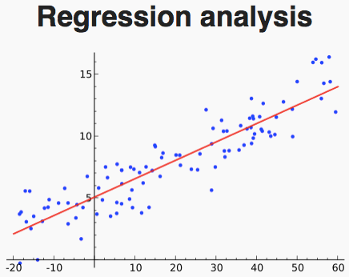
The ADH Analysis
Regression analysis
ADH used standard statistical techniques to estimate the relationship between the two variables.

Slide 37
The ADH Analysis
Regression analysis
ADH used standard statistical techniques to estimate the relationship between the two variables.
Table 3 shows results for manufacturing only
Col 1: OLS = Ordinary Least Squares
Cols 2-3: 2SLS = Two-Stage Least Squares

Slide 38
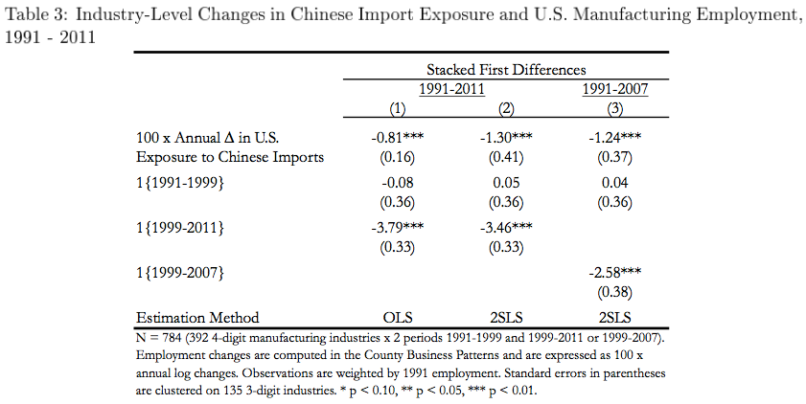
Estimated change in employment associated with a 1-percentage point rise in import penetration
“Dummy variables” for time periods: Ignore
Three stars mean probability that true effect is zero is less than 1%.
Thus highly “statistically significant”

Slide 39
The ADH Analysis
Why 2SLS?
OLS results “could be biased because growth in import penetration is driven partly by domestic shocks.”
”Correlation is not causation”
2SLS avoids this bias by using “instrumental variables”
Here these are import penetration from China in countries other than the US

Slide 40
The ADH Analysis
Regression analysis
ADH used standard statistical techniques to estimate the relationship between the two variables.
Table 3 shows results for manufacturing only
Col 1: OLS = Ordinary Least Squares
Cols 2-3: 2SLS = Two-Stage Least Squares
These estimates can be used to plot maps of how parts of the US have been affected

Slide 41
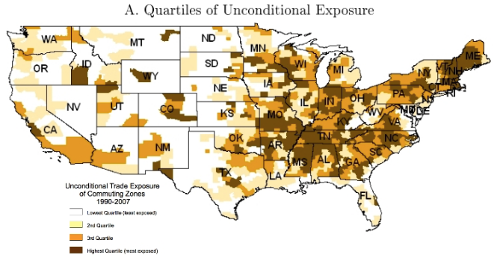
This map mainly just shows where manufacturing is, and isn’t
Next map controls for this

Slide 42
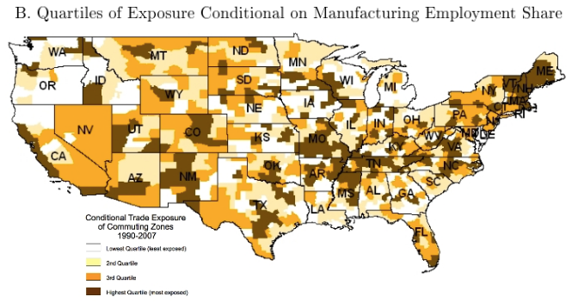
This map captures, for whatever manufacturing there is in a place, the extent to which it competes with imports from China

Slide 43
Clicker Question
Why is SE Michigan a lighter shade in the second map than the first?
The second shows that population has moved away from Michigan
The auto sector was not impacted by imports from China
Michigan does most of its trade with Canada
More manufacturing is concentrated here than in much of the country
✓

Slide 44
The ADH Analysis
Effects on other things
Table 4A shows that import penetration causes
Fall in employment in non-manufacturing
Rise in unemployment
Rise in “not in labor force”
Table 4B shows that it also causes
Fall in population
Fall in wage
Rise in transfers (from government)

Slide 45
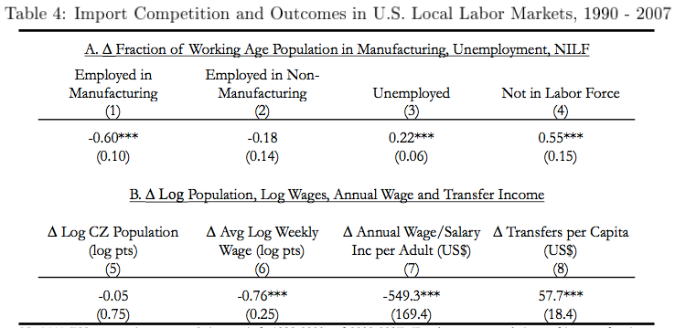

Slide 46
Discussion Question
Why would the China Shock cause each of these effects in localities with increased imports?
Fall in employment in non-manufacturing
Rise in unemployment
Rise in “not in labor force”
Fall in population
Fall in wage
Rise in transfers (from government)

Slide 47
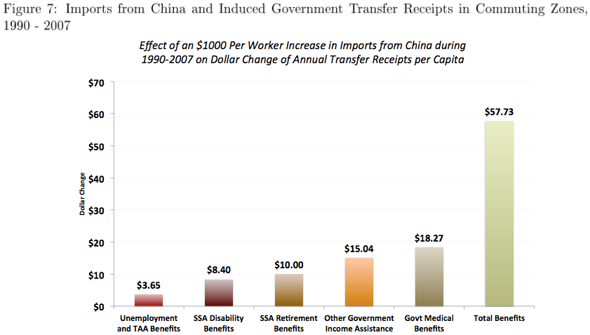
Note how small is the contribution of Trade Adjustment Assistance

Slide 48
The ADH Analysis
Persistence
Another finding of ADH (I won’t show the graph) is that displaced workers tend either to remain in their same trade-impacted industry or move to another that is also vulnerable.
“Labor-market adjustment to trade shocks is stunningly slow”

Slide 49
The ADH Analysis
The China Shock: ADH Concluding Comments
“Employment has certainly fallen in U.S. industries more exposed to import competition.”
“so too has overall employment in the local labor markets in which these industries were concentrated”
“Offsetting employment gains … have, for the most part, failed to materialize.”
I question this, though, since US unemployment is so low
But: “The great China trade experiment may soon be over, if it is not already.”

Slide 50
Clicker Question
Why do ADH suggest that the China Shock “may soon be over, if it is not already”?
Wages are rising in China
President Trump is discouraging imports from China and may raise tariffs
US manufacturing is so low, it cannot fall any further
It will be replaced by an Africa Shock: a large increase in imports from Africa
✓

Slide 51
Class 4 Outline
China Shock
China’s growth
The China Shock
The ADH analysis
Other sources

Slide 52
Other Sources
Arnold, in a reading from NPR, says
(Not really another source, since he’s quoting David Autor, the A of ADH.)
“from 2000 to 2007, trade with China destroyed nearly 1 million U.S. manufacturing jobs.”
But the graph there shows jobs falling by about 6 million. So China trade was only a small part of the drop.

Slide 53
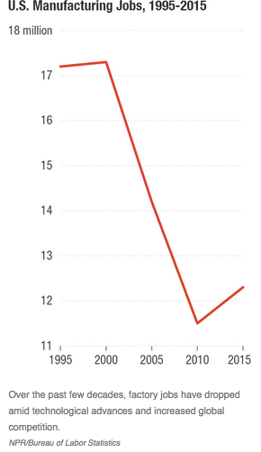

Slide 54
Other Sources
Davis & Hilsenrath:
Again not really a different source. This quotes Gordon Hanson, the H of ADH
China was important even for jobs lost to Mexico: “Many U.S. factories that moved to Mexico did so to match prices from China.”
“‘If we encouraged China to trade, we needed domestic policies in place that would minimize the impact that would follow.” We didn’t have those.

Slide 55
Clicker Question
Why has the China Shock been worse than the rise of imports from Japan in the 1980s?
Japan exported goods that the US did not make.
Japan was a political ally of the US, but China is not.
Japan’s exports were concentrated in a few industries, unlike China’s.
Japan is a much smaller country than China.
✓

Slide 56
Other Sources
Economist, “Economists Argue about the Impact of Chinese Imports on America”
Work by Rothwell criticizes the results of ADH
For using import data from Europe rather than the US
For the timing of the ADH data
For the way that the ADH results have been interpreted by the public, not recognizing that there were large consumer gains from the China Shock, as well as losses

Slide 57
Other Sources
Krugman
Argues that it has not been trade itself that caused the costs observed by ADH, but rather its rapid rate of change
This is relevant because a reversal of policy to reduce trade (by Trump?) would be equally damaging

Slide 58
Discussion Question
What should the United States have done differently with regard to trade with China?

